Slide 1
U.S. Refining Industry Darkest before the Dawn?
presented by
John R. Auers, P.E.
Sr. Vice President of Turner, Mason & Company
The New York Energy Forum
February 22, 2010

Slide 2
Turner, Mason & Company
International engineering consulting practice since 1971
Downstream focus
Publish semi-annual Outlook for subscribers:
Petroleum supply/demand
Survey of refinery projects
Detailed price forecast (crude/products)
Publish Annual World Crude Outlook with EIG
Slide 2

Slide 3
Tonight’s Agenda
Current Environment – Doom and Gloom
Backward Look – Have We Been Here Before?
Some Reasons for Optimism
Forecasting the Future (?)

Slide 4
The Current Environment

Slide 5
Can Refining Get Any Worse?

Slide 6
Investment Community’s Views
Credit Suisse – “The Golden Age is over. We believe we are entering the dark ages “(July 2008).
Credit Suisse – “Dark Ages Continue for Refiners” (Nov. 2009)
Forbes Magazine – “Refining is a Rotten Biz” (Dec. 2009)
UBS – “There will be significant excess capacity, despite project cancellations “– (April 2009)
Barclays - “global refining utilization rate will remain 82% through 2011 even if 2 MMBPD is shut down” (Jan. 2010)

Slide 7
Industry Views – not much better
Exxon – “refining margins will decline as refineries continue to improve efficiency; in the near term, new capacity outpaces growth in global demand” (Annual Report 2009)
Shell – “significant overhang of industry refining capacity; exacerbated by the economic downturn.” (4Q09 Earnings call Feb. 2010)
Chevron – “we have had a view that upstream provides better returns” (Analyst briefing - Jan. 2010)
Valero – “the refining industry remains challenging;” says we should be “profitable” in 2010. (Earnings Call-1/27/10)

Slide 8
Downstream Earnings Have Collapsed
 | $ MM
 | 4Q09 | 4Q08 | Decline
Integrateds
ExxonMobil | (287) | (20) | (267)
ConocoPhillips | (314) | 380 | (694)
Chevron | (345) | 1,033 | (1,378)
Marathon | (18) | 325 | (343)
Hess | 17 | 152 | (135)
Murphy | (4) | 141 | (145)
Total |  |  | (2,962)
Independents
Valero | (111) | 1,312 | (1,423)
Tesoro | (123) | 204 | (327)
Holly* | (12) | 51 | (63)
Frontier* | (49) | 33 | (83)
Alon* | (50) | 63 | (113)
Sunoco | (114) | 249 | (363)
Western* | (47) | 33 | (80)
Total |  |  | (2,452)
Total Decline |  |  | (5,414)
*4Q09 earnings based on consensus estimates

Slide 9
Equity Values Have Likewise Tanked
 | Peak Date | Peak | Feb. 2010 | Decline
S&P 500 | Oct-07 | 1,561 | 1,066 | -32%
Valero | Jun-07 | 73.86 | 17.80 | -76%
Tesoro | May-07 | 61.88 | 11.81 | -81%
Holly | Jun-07 | 74.19 | 26.59 | -64%
Frontier | Oct-07 | 45.79 | 12.48 | -73%
Alon | Jul-07 | 46.11 | 6.77 | -85%
Sunoco | Jan-06 | 95.20 | 25.50 | -73%
Western | Jul-07 | 62.66 | 4.17 | -93%
Avg. Decline |  |  |  | -78%
Note: Feb. 2010 data taken 2/11/10.

Slide 10
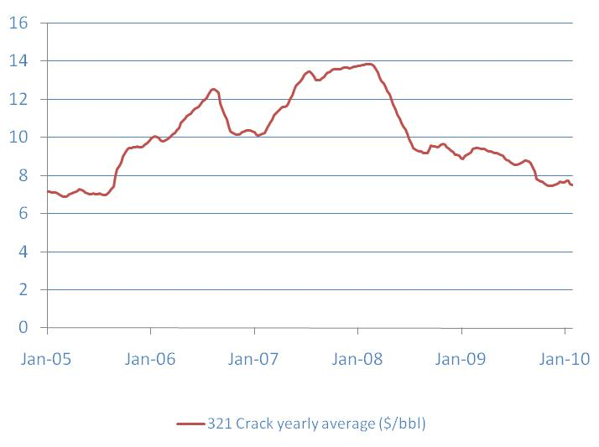
Margins Off Sharply From “Golden Age Levels”
Golden Age

Slide 11
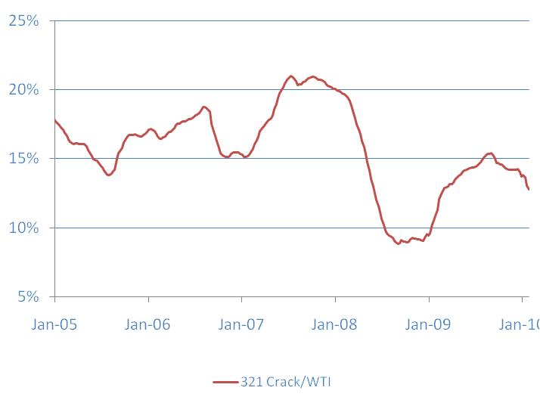
Gross Margin Decline Even Greater
Golden Age

Slide 12
Product Demand Has Fallen Sharply

Slide 13
While Refining Capacity Grows

Slide 14
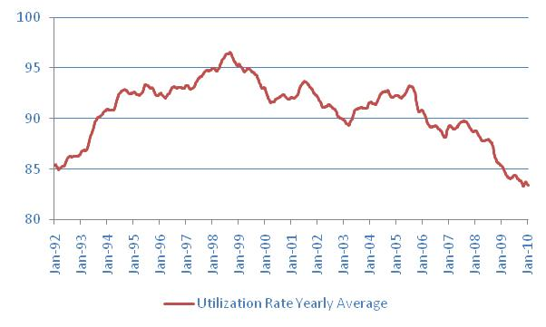
Utilization Rates At Early ‘90 Levels

Slide 15
Capacity Will Keep Growing From “Golden Age” Projects
U.S. Expansions
Marathon Garyville (180 kbd) – Project complete; start-up expected after March 2010 T/A.
Motiva Port Arthur (300 kbd) – 2012 start-up.
Worldwide Capacity Growth
Reliance/India (580 kbd) – Started up in 2009; Market still trying to absorb additional product
4.5 million B/D of additional capacity planned in next 3 years (TM&C estimate) – more than half in Asia Pacific region
Other analysts have even higher estimates

Slide 16
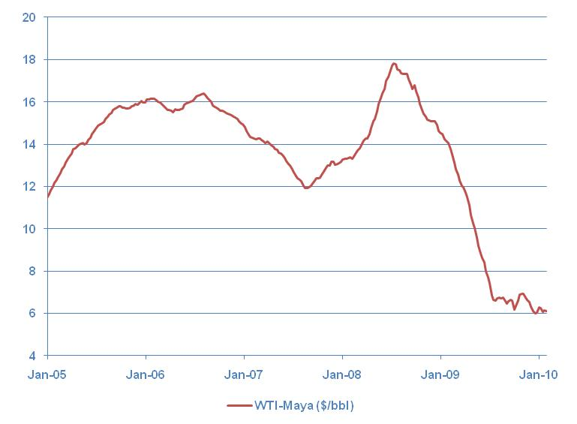
Fall In Heavy Crude Discounts Hurts Deep Conversion US Refiners

Slide 17
U.S. Refineries Shuttered So Far
Owner | Refinery | Capacity (KBPD) | Date of Closure
Big West | Bakersfield, CA | 65 | Jan 2009
Valero | Aruba * | 235 | July 2009
Sunoco | Eagle Pont, NJ | 150 | Oct 2009
Valero | Delaware City, DE | 210 | Nov 2009
Western | Bloomfield, NM | 17 | Dec 2009
Total |  | 677
* Serves U.S. market predominantly

Slide 18
More Regulations Could Be “Final Nail in Coffin”
Carbon Legislation
Waxman-Markey Bill
EPA Endangerment Finding
Alternative Fuels
EPA Proposed Ozone Rules

Slide 19
Backward Look –
Have We Been Here Before?

Slide 20
Looks Like Late 70’s and Early 80’s?
Substantial crude price increase leading to recession and demand destruction
Government proposals mandate lower consumption and alternative fuels
Predictions of “doom and gloom” for the oil industry
Analysts and industry participants say US gasoline peaked in 1978
Major oil companies react by diversifying away from petroleum (Mobil/Mont. Ward, Exxon/Shale Oil,Typewriters and Electric Motors, etc.)

Slide 21
Followed by “Dark Ages”
1980’s and 1990’s were extremely tough for the industry

Slide 22
Refining Returns Stayed Below 10%

Slide 23
Refineries Sold For “Pennies on the Dollar”
U.S. Refinery Sales

Slide 24
Followed by “Dark Ages”
1980’s and 1990’s were extremely tough for the industry
1980’s and 1990’s were extremely tough for the industry
Capacity surpluses were present both worldwide and in the US, leading to very low utilization rates

Slide 25
Refining Surplus Caused Low Utilizations

Slide 26
Followed by “Dark Ages”
1980’s and 1990’s were extremely tough for the industry
Capacity surpluses were present both worldwide and in the US, leading to very low utilization rates
Spurred by low prices, demand resumed, but external events postponed the return to profitability
US gasoline and distillate demand finally surpassed 1978 levels in the mid-1990’s
The Asian banking crisis of 1999 and the 9/11 recession delayed the “Golden Age”

Slide 27
US Gulf Coast Refining Margins
Golden Age

Slide 28
Some Reasons For Optimism

Slide 29
Reasons For Optimism
US industry structural changes
Regulatory impacts perhaps not as bad as feared
Fast growth in emerging markets
Reduction in Surplus Capacity

Slide 30
US Industry Structural Changes – Independents Rule
Rise of Independents changed refining dynamics
Independents share of US refining has grown to 46% (from 35% in 1994)
Refining has become a profit center rather than a cost center
Consolidation has also taken place
Share of top 10 companies have grown from 52% to 77% since 1994.

Slide 31
Top 10 Refiners – Current vs. 1994
Refiners | 2010 Capacity (KBPD) |  | Refiners | 1994 Capacity (KBPD)
ConocoPhillips | 2,226 |  | Chevron | 1,373
Valero | 2,210 |  | Exxon | 990
ExxonMobil | 2,065 |  | Amoco | 984
BP | 1,478 |  | Mobil | 903
Marathon | 1,196 |  | Shell | 739
Shell | 959 |  | BP | 666
Chevron | 941 |  | Texaco | 600
Citgo | 849 |  | Hess | 575
Sunoco | 825 |  | Marathon | 570
Flint Hills | 817 |  | Sunoco | 470
Total | 13,566 |  | Total | 7,870

Slide 32
The Evolution of a Powerhouse
Valero
(2.2 mmbd – present)
Valero
Valero
UDS
Premcor
Williams
Clark Refining
Orion
Diamond Shamrock
Ultramar
Williams
Mapco
Total N. America
Valero
Huntway
Salomon (Basis)
Valero
(95 kbd-1994)
Coastal (Aruba)
Slide 32

Slide 33
U.S. Industry Structural Changes – More Competitive Refineries
Rationalization during the “dark ages” of the 80’s and 90’s produced a much leaner, more complex and competitive system.
The number of U.S. refineries halved from 301 in 1982 to 150 currently.
Average size and complexity has increased.

Slide 34
Improvements in U.S. Refining System
 | Average Capacity (kbd) | Total Cracking % of Crude | Coking Capacity % of Crude
1982 | 68 | 34% | 9%
2010 | 144 | 41% | 14%

Slide 35
U.S. Industry Structural Changes – More Competitive Refineries
The U.S. refining system is far and away the most sophisticated in the world.

Slide 36
U.S. Refiners Are The Most Complex
Region | Cat Cracking Capacity | Hydro-cracking Capacity | Coking Capacity | Upgrading Capacity
U.S. | 32% | 9% | 14% | 55%
Asia | 13% | 5% | 2% | 20%
Europe | 12% | 6% | 2% | 20%
World | 17% | 6% | 5% | 28%
Upgrading ability is total conversion capacity as percentage of distillation capacity

Slide 37
U.S. Industry Structural Changes – More Competitive Refineries
The U.S. refining system is far and away the most sophisticated in the world
Capable of producing high yields of “ultra-clean” fuels
Can run lower cost heavy, high sulfur crudes

Slide 38
Onerous Carbon Regs Now Less Likely
Political developments making passage of Waxman-Markey or similar legislation unlikely (at least this year)
Difficulties with healthcare legislation
Loss of Senate super-majority
Election year dynamics
Limited success of Copenhagen Conference
BP and COP exit Climate Partnership
EPA CO2 endangerment finding facing significant legal challenges and public opposition

Slide 39
Alternative Fuels Impact Limited for Next 15 Years
Ethanol – hitting 10% blend wall limit set by auto makers
Cellulosic ethanol remains in pilot testing phase
Biodiesel market has cratered with loss of blending credit
Natural Gas vehicles – infrastructure remains an issue
Electric vehicles/plug in hybrid – High cost/Limited range
Chevy Volt -$40K/40 miles
Tesla-$100 K/200 miles

Slide 40
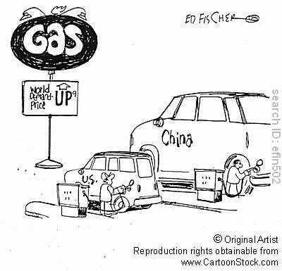
Energy Markets No Longer U.S. Centric

Slide 41
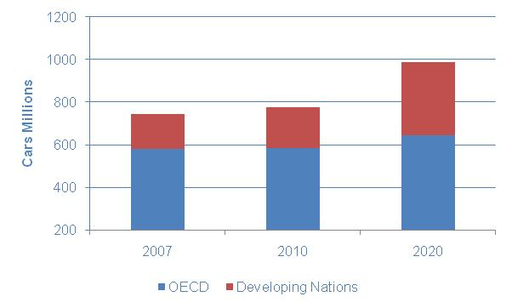
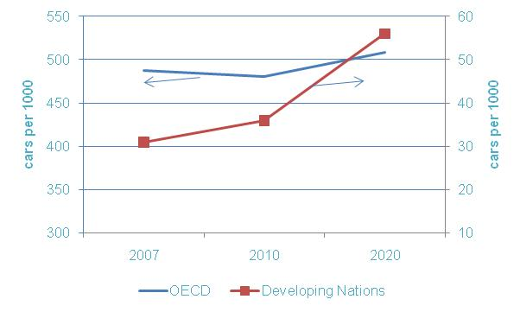
Developing World To Provide Growth
OECD to remain flat
Early stage of growth

Slide 42
Situation Much Different Than Before
Early 80’s
China/India still controlled/stagnant economies – avg. GDP growth of 5% in 1980’s
EM only 34% of world petroleum demand
Excess refining capacity in much of the world – due to govt. policies/incentives
Now
China/India economies growing fast – avg. GDP growth expected to be 9%
EM now 45% of world petroleum demand and growing
Refining capacity only three years removed from “Golden Age” shortages; surplus caused by recession

Slide 43
Less Capacity Growth by Mid-Decade
Market sensitive refining industry will continue to rationalize capacity
Depressed market, limited access to capital and uncertain prospects will result in very few new projects
Spending in 2010 is expected to drop by 30%

Slide 44
2010 Capex Reduced
 | $ MM
 | 2010E | 2009 | '10-'09
Integrateds
ConocoPhillips | 1,300 | 2,076 | (776)
Chevron | 3,400 | 4,421 | (1,021)
Marathon | 1,100 | 2,570 | (1,470)
Hess | 50 | 118 | (68)
Murphy | 400 | 376 | 24
Total | 6,250 | 9,561 | (3,311)
Independents
Valero | 2,000 | 2,700 | (700)
Tesoro | 600 | 542 | 58
Holly* | 200 | 350 | (150)
Frontier* | 110 | 190 | (80)
Alon* | 100 | 80 | 20
Sunoco | 444 | 460 | (16)
Total | 3,454 | 4,322 | (868)
Total | 9,704 | 13,883 | (4,179)
*Have not provided 2010 capex budget update

Slide 45
Less Capacity Growth by Mid-Decade
Market sensitive refining industry will continue to rationalize capacity
Depressed market, limited access to capital and uncertain prospects will result in very few new projects
Spending in 2010 is expected to drop by 30%
The capex that is being budgeted is for regulatory compliance and reducing costs – not adding capacity

Slide 46
Asian Expansion For Regional Demand – No Excess To Export

Slide 47
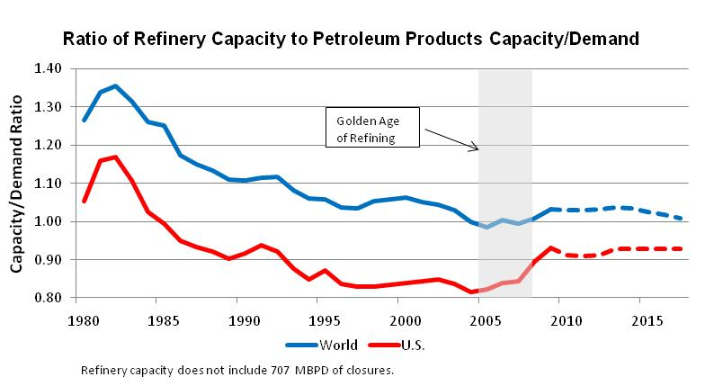
Market To Tighten By 2016

Slide 48
Forecasting The Future (?)

Slide 49
It’s Tough to Do
“Prediction is very difficult, especially of the future .“ - Neils Bohr
“No one can possibly know what is about to happen: It is happening, each time, for the first time, for the only time.” – James Baldwin

Slide 50
TM&C Crude And Refined Products Outlook
Issued bi-annually
2010 Outlook issued in early February
Worldwide coverage
Primary Areas of Focus
Product demand
Crude and refined product prices
Refinery construction forecast

Slide 51
Key Questions
Product Demand – How much; Where; Which products
Refining Capacity – New projects; shutdowns
Impact of regulations – Alternative fuels; carbon limitations; other
Crude Production – How much; Where; What grades
Effect of all of the above on Prices and Margins

Slide 52
Economic & Demand Assumptions
GDP Growth
Worldwide GDP to recover to long-term average of about 4% in next 2 to 3 years
US GDP growth will average 2.6% long term
Petroleum Product Demand
Worldwide growth to average 1.4%/year through 2025, led by developing countries
US demand growth to average 0.4%; somewhat stronger in next two years as it recovers from recession lows
Distillate to grow faster than gasoline

Slide 53
Product Demand Outlook (Total - MMBPD)
 | Actual 2009 | 2010 | Forecast 2015 | 2020
U.S. | 18.7 | 19.0 | 19.4 | 19.6
Europe (ex. FSU) | 15.5 | 15.5 | 15.7 | 15.8
Asia (ex. FSU) | 25.2 | 25.6 | 28.9 | 32.3
Rest of the World | 23.5 | 23.9 | 26.2 | 28.8
World | 82.9 | 83.9 | 90.3 | 96.5

Slide 54
Product Demand Outlook (Total Growth Increase - MMBPD)
 | 2009 to 2020 | % of Total
U.S. | 0.9 | 7
Europe | 0.3 | 2
Asia Pacific | 7.1 | 52
Rest of the World | 5.3 | 39
Total World | 13.6

Slide 55
Crude Oil Outlook
World crude spare capacity gradually tightens from more than 5 million B/D currently to below 3 million B/D by 2015.
Oil prices to follow an increasing trajectory, but to be very volatile. Sustained periods above $100/B or below $60/B are not expected.

Slide 56
Product Supply Outlook
Many major refinery projects for 2012-2015 completion have been delayed or cancelled.
A total of over 5.5 million B/D of capacity additions have been removed from our Outlook over the past two years.
India/China market the exception
Very few if any new projects to increase capacity are being developed.
Surplus refining capacity will begin to stabilize over the next couple of years and start to fall by mid-decade

Slide 57
Refinery Construction Outlook (Total Capacity Increase - MMBPD)
 | 2010 to 2016 | % of Total
U.S. | 0.8 | 11
Asia Pacific | 3.1 | 44
Middle East | 1.1 | 20
Rest of the World | 1.5 | 24
Total World | 7.0

Slide 58
Refinery Rationalization – U.S.
Continued tight margins and excess capacity over the short term will challenge the economic viability of some refineries
Slowdowns and consolidations will be more prevalent than shutdowns in the U.S.
At-risk plants include:
Smaller/less complex plants
Non-core/ low performing facilities
Plants with financially weak owners
Facilities unable to meet new regs economically

Slide 59
Refinery Rationalization – World
European refineries are at greatest risk
Structural excess capacity is greater than in the U.S.
No expectations of increased product demand growth
U.S. demand for European gasoline will decrease
Penetration of alternative fuels greater than in U.S.
More threatened by new ME and Asian export refineries
At-risk plants include:
Smaller and/or less complex plants such as Teeside
Obsolete and uncompetitive plants; many in the East
Plants with poorer access to and capability of processing changing crude avails

Slide 60
TM&C Price and Margin Outlook ($/B)
 | Actual 2009 | 2010 | Forecast
 |  |  | 2015 | 2020
WTI (Cushing) | 61.69 | 72.00 | 84.00 | 94.00
WTI- Maya | 5.19 | 7.00 | 10.00 | 15.00
USGC 3:2:1 Crack | 7.60 | 6.50 | 9.75 | 11.00

Slide 61
TM&C/EIG World Crude Oil Outlook
Forecast of world crude production by country and grade through 2020.
A new approach to reserve estimation
Reserve and production forecasts categorized by grade type
Integrated approach which considers supply and demand for different crude grades based on refining capacity additions and modifications

Slide 62
World Crude Oil Outlook 2010-2020 Key Conclusions
The world is not running out of oil, nor has worldwide crude oil production potential or capacity peaked.
The distribution of current crude oil production differs significantly from reserves, both geographically and by crude type.
Heavy crude production in the next decade will begin to mirror the abundance of heavy reserves.
Increase in Crude Production by Hemisphere
(2008 to 2020)

Slide 63
World Crude Oil Outlook 2010-2020 Key Conclusions
Worldwide refining capacity additions will add to what has become a significant surplus.
The surplus in Heavy crude refining capacity will limit the Heavy crude discount in the near term, but this discount will grow in the second half of the decade.
Cumulative Refinery Capacity Surplus
(over 2008 levels)

Slide 64
Final Thoughts
Refining will be a tough business for the next few years, but there are reasons to be optimistic.
The US refining industry is better positioned to withstand and react to downturns currently than it was in the past.
The pessimism of today, which is causing cuts in capital spending on the downstream, could provide fuel for a recovery in refining profits by the middle of the decade.
Heavy crude discounts, which are very important to U.S refiners, will be slow to improve in the short term, with a brighter outlook in the second half of the decade.

Slide 65
Final Thoughts (cont.)
Economic and technical factors will keep the penetration of alternative fuels limited through 2025.
The recovery of product demand is the most important factor for the health of refining. Demand growth in the developing economies of Asia and the Middle East will be of paramount importance.
We do not expect onerous regulations to be enacted which significantly disadvantage the US refining industry, but if they are, all bets are off.

Slide 66
Presenter
John R. Auers – Senior Vice President
Email: jauers@turnermason.com
Telephone
214-754-0898
Address
Ste 2920, L.B. 38
2100 Ross Ave.
Dallas, Texas. 75201

